Slide 1
Resale Car Price Prediction With ML & Data Science skills Prepared By : Ms.Sonal S.Shirbhate

Slide 2
Contents
Introduction
Data Cleaning
Data Preprocessing
Exploratory Data Analysis
Graphs Plotting For Relationships In The Data
Data Preparation For Machine Learning Model
Design Machine Learning Model
Predication using Machine Learning
User Interface For Input And Display The Output

Slide 3
Introduction
We Are Excited To Finally Submit The Capstone Project.
This Project Is Opportunity us To Present Our Data Science Skills.
The Project Includes Car Details Dataset. We Have Used Data Science Skills And Perform The Below Mentioned Tasks Using Various Tools And Technologies Which We Have Learned.
Our Project Contains Below Mentioned Actionable And We Made Appropriate Use Of Relevant Tools And Technologies.
We Derive Insights From Data And Performed Eda And Deployed a ML Model Using Streamlit & Github.

Slide 4
Problem Statement
We have to Perform EDA And Derive Insights From The CAR DETAILS Dataset Using Various Data Analysis And Data Visualization Libraries Of Python Such As Pandas, Matplotlib & Seaborn. Create And Deploy a ML Model Which Can Be Accessed By All, Using Streamlit And Github.

Slide 5
Tools,Technologies & Skills Used
1 | Pandas
2 | Matplotlib
3 | Seaborn
4 | Ml
5 | Numpy
6 | Tkinter
7 | Sklearn
8 | Streamlit
9 | Github
10 | Google Colab
11 | Excel
12 | Visual Analysis

Slide 6
Performed Steps
1. We Explored The Data Using Excel Then Understand That Data And Prepared A Short Summarry About The Dataset As Below
we received CSV data file . It Is Huge Upto 4340 Rows And 8 Column.
All Columns Containing The Relational & Interdependant Data Which Describe About Vehicle Details.
It Contains Information Like Model Name,selling Price,manufacturing Year,killometer Driven, Seller Type,fuel Type,transmission Type,ownership Etc.
We analyse that this data contains the information about resell vehicles and its pricess accordingly.
Model Name- It Gives The Info About Manufacturer,model Type And Specific Feature.
Manufacturing Year- Which Year Vehicle Is Manufactured.
Killometer – It Tells How Much Killometer Vehicle Is Driven.
Selling Price- Price Offered By Th E Owner.
Seller Type- It Defines Seller Is Individual Or Dealer Or Trusted Dealer
Fuel Type- Vehicle Fuel Type Like Deisel,petrol ,CNG,LPG Or Electric.
Transmission Type - Gives The Details About Vehicle Gearbox Type Automatic Or Manual.
Ownership Type- We Getting Idea About Owenership Is 1st,2nd,3rd Etc

Slide 7
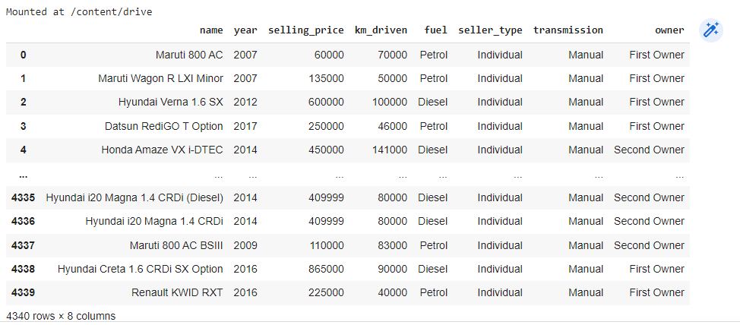
Sample Dataset

Slide 8
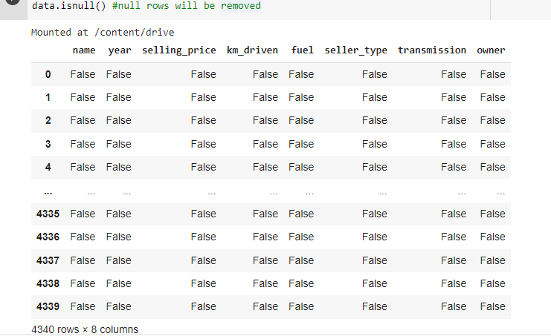
Data Cleaning
Null value: As we see there is no null value in 'Price', our main target variable is price.

Slide 9
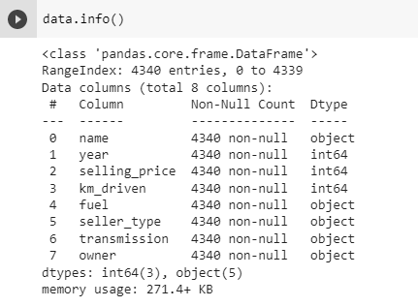
Data Cleaning
After loading the dataset, the shape of the dataset is (4340,8).
We have to check for duplicates, null values and the data types.
We see null values in name, year,km drive, selling price, seller type, fuel type, transmission and owner, we impute them.
All the data types are good except mileage and price, so we find the wrong data and correct them.

Slide 10
Data Preprocessing
2. After the analyzing data visually Data Cleaning is one of the important steps in EDA. Data cleaning can be done in many ways. One of them is handling missing values. We Used the various methods such as Handling null values, One-Hot Encoding, Imputation and Scaling of Data Pre-Processing where necessary.
we verify whether Null values are present or not in our data set but no null values present.
we used one hot Encoding it is one method of converting data to prepare it for an algorithm and get a better prediction. Some of functions as belows
Imputation it replaced missing values by substituting missing data with a different value we checked our dataset but no values is missing in our dataset.
Feature scaling is a method used to normalize the range of independent variables or features of data. In data processing.
we have listed some of functions below.

Slide 11
Some of function used
value_counts() Function is used to get a Series containing counts of unique values.
data.shape Find Shape of Our Dataset (Number of Rows And Number of Columns)
data.info() Get a quick overview of the dataset we use the dataframe
data.describe() Get Overall Statistics About The Dataset
data.head() Method is used to return top n (5 by default) rows of a data frame or series.
data["name"].unique () The UNIQUE function returns a list of unique values in a list or range.
data.dtypes describes how the bytes in the fixed-size block of memory corresponding to an array item should be interpreted.

Slide 12
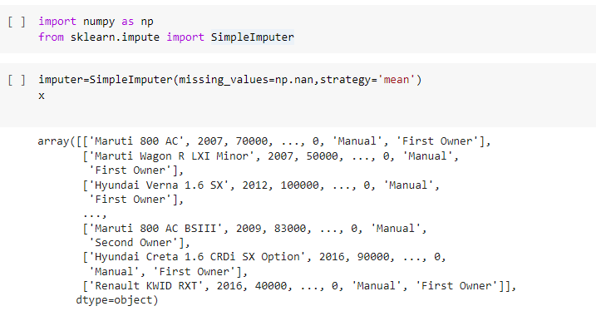
Data Preprocessing
There is no duplicate or missing values of the overall statistics of data.

Slide 13
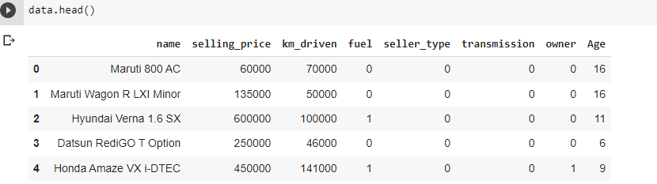
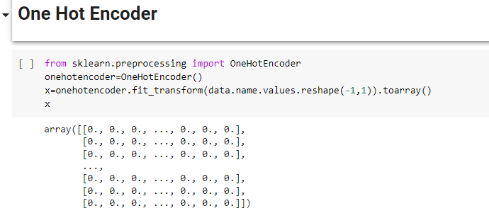
Data Preprocessing

Slide 14
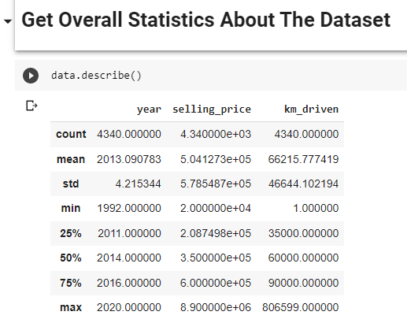
Data Preprocessing
Outliers and inconsistent data points often tend to disturb the model’s overall learning, leading to false predictions.

Slide 15
Exploratory data analysis (EDA) and Graphical Analysis
EDA Is A Data Analytics Process To Understand The Data In Depth And Learn The Different Data Characteristics, Often With Visual Means.
Graphical Data Analysis Is Useful For Data Cleaning, Exploring Data Structure,
Detecting Outliers And Unusual Groups, Identifying Trends And Clusters, Spotting Local Patterns, Evaluating Modelling Output, And Presenting Results.
We understand & explore the fruitful details from drawing our dataset graphs for easy and quick understanding of complete dataset meanings for easy decision making by visualization only.
We have given some of examples below.

Slide 16
List Of Some Chart Prepared
Year vs Counts(vertical and horizontal bar graph)
Year vs Year Category Counts
Selling Price vs Counts
Fuel vs Counts
Seller vs Counts
Transmission Counts Percentage Distribution
Km Driven vs Counts
Seller vs Seller Type Counts
Owner vs Owner Category Counts
Mean price of car on various Atributes

Slide 17
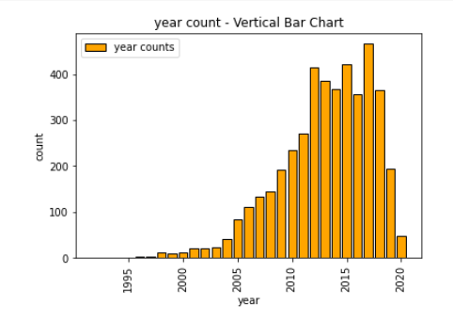
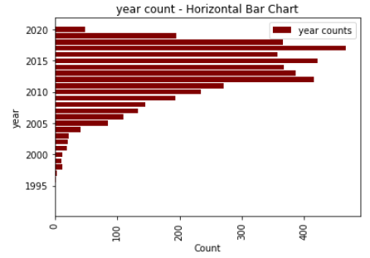
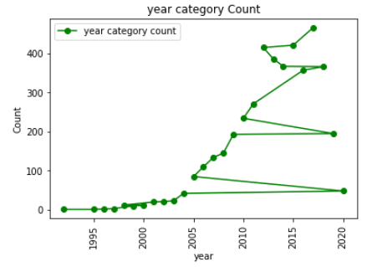
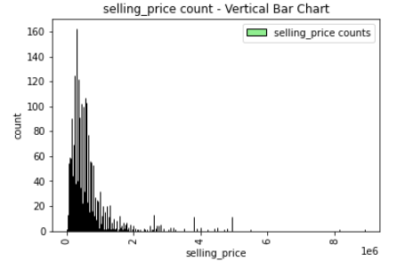

Slide 18
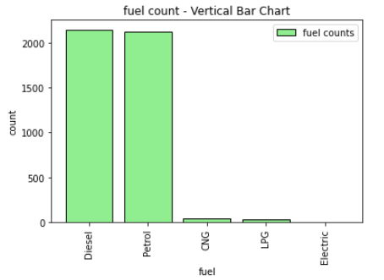
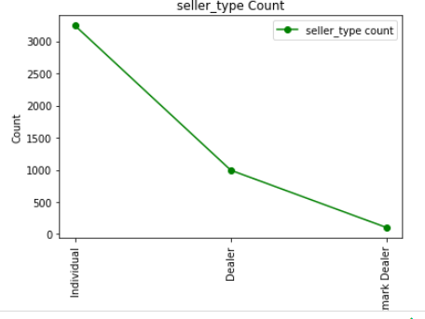
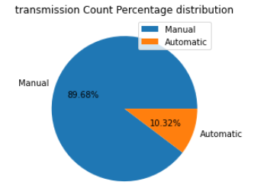
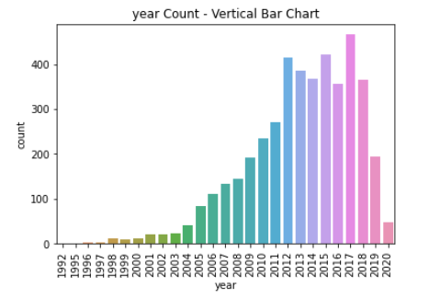

Slide 19
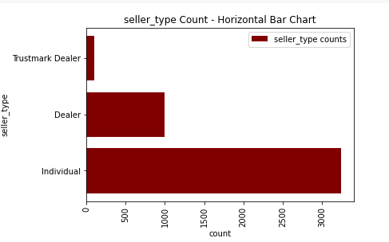
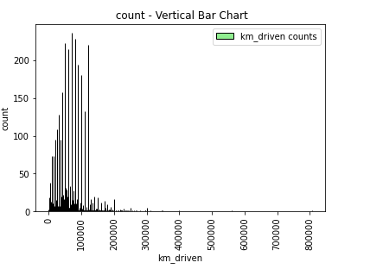
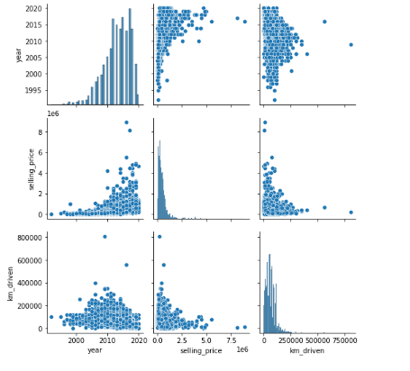
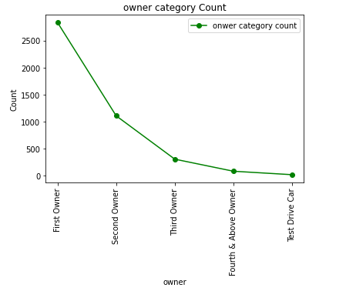

Slide 20
3.Prepare the Data for Machine Learning modeling.
Machine learning and data preprocessing isThe process of transforming raw data so that data scientists and analysts can run it through machine learning algorithms to uncover insights or make predictions
store Feature Matrix In X and Response(Target) In Vector y
X = data.drop(['name','selling_price'],axis=1)
y = data['selling_price']
The drop() method removes the specified row or column.
By specifying the column axis (axis='columns'), the drop() method removes the specified column.
By specifying the row axis (axis='index'), the drop() method removes the specified row.
from sklearn.model_selection import train_test_split
X_train,X_test,y_train,y_test=train_test_split(X,y,test_size=0.20,random_state=42)
x_train : The training part of the first sequence ( x )
x_test : The test part of the first sequence ( x )
y_train : The training part of the second sequence ( y )
y_test : The test part of the second sequence ( y )

Slide 21
4.Apply various Machine Learning techniques such as Regression or classification ,Bagging, Ensemble techniques and find out the best model using various Machine Learning model evaluation metrics.
Machine learning techniques -Import The models
from sklearn.linear_model import LinearRegression
from sklearn.ensemble import RandomForestRegressor
from sklearn.ensemble import GradientBoostingRegressor
from xgboost import XGBRegressor
Model Training
Training a model simply means learning (determining) good values for all the weights and the bias from labeled. training time is the time taken by a model to train on a dataset, and the execution time represents the total time taken for computations, including data splitting, data preprocessing, and model evaluation

Slide 22
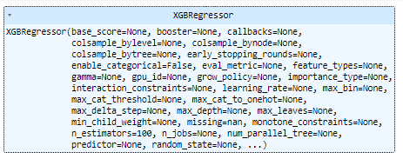
lr = LinearRegression()
lr.fit(X_train,y_train)
rf = RandomForestRegressor()
rf.fit(X_train,y_train)
xgb = GradientBoostingRegressor()
xgb.fit(X_train,y_train)
xg = XGBRegressor()
xg.fit(X_train,y_train)

Slide 23
Prediction on Test Data
To predict the digits in an unseen data is very easy. You simply need to call the predict_classes method of the model by passing it to a vector consisting of your unknown data points. Now, as you have satisfactorily trained the model, we will save it for future us
XGBoost is an implementation of gradient boosted decision trees designed for speed and performance that is dominative competitive machine learning.
y_pred1 = lr.predict(X_test)
y_pred2 = rf.predict(X_test)
y_pred3 = xgb.predict(X_test)
y_pred4 = xg.predict(X_test)
Evaluating the Algorithm
During the training, you give the algorithm a dataset that contains correct answers (label y). Then, you validate the model accuracy with a test data set with correct answers. A data set must be split into training and test sets.
final_data = pd.DataFrame({'Models':['LR','RF','GBR','XG'],
"R2_SCORE":[score1,score2,score3,score4]})

Slide 24
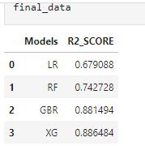
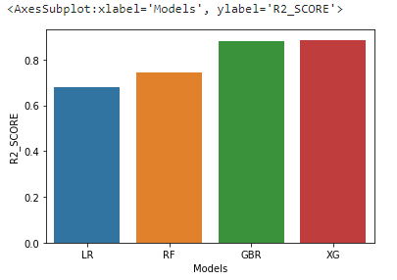
Evaluating the Algorithm

Slide 25
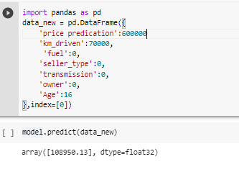
5. Save the best model and Load the model.
xg = XGBRegressor()
xg_final = xg.fit(X,y)
import joblib
joblib.dump(xg_final,'price_predictor')
['price_predictor']
model = joblib.load('price_predictor')
Prediction on New Data

Slide 26
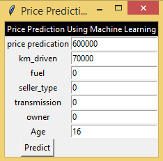
User Interface For Input And Display The Output GUI

Slide 27
Conclusion
Thus We Have Performed EDA And Derive Insights From The CAR DETAILS Dataset Using Various Data Analysis And Data Visualization By Using Libraries Of Python Such As Pandas, Matplotlib & Seaborn.Also Did Price Predication Using Machine Learning Model . We Created And Deploy A ML Model Which Can Be Accessed By All, Using Streamlit And Github.
Links:
Data Cleaning & Pre-Processing with ML Model code file.
https://colab.research.google.com/drive/1rEc2G6KR8OwMhbLuyIqfyIOFQ07GDIir#scrollTo=7muTynT7EJzt
Graphical Analysis code file
https://colab.research.google.com/drive/1UeEMCC3eq2MFmwCWviiNNLcnJ8XphWqt#scrollTo=h1Sb5IIfsR4h

Slide 28
Thank you……….!!

